Slide 1

Creating the next hit video game
By Kasha Cepok
Notes:
Creating the next hit videogame using data analysis
Independent video games developer
Optimise the success of their next video game by finding out what makes a game popular and what kind of audience to target

Slide 2

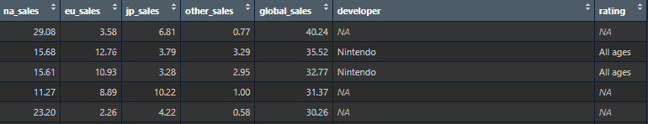
Data
Metric of Success
Global sales, Regional sales
Platform, Genre, Publisher, Rating
Name, Year of release, Developer
Predictors
Others
Notes:
Here is what the dataset looked like
Metric for success – all time global sales, regional sales
Predictors – platform, genre, publisher, rating
Other data – name, year of release, developer
Each row represents 1 game

Slide 3


A quick note on modelling…
We can’t make a model
But we can gain some insight from the process!
Notes:
A model tells us about the relationship between our metric of success and the variables in our data
Bad news: We can’t model this data due to the nature of the variables
Because global sales is broken down by region, when trying to model the data the model sees that these add up to equal our global sales, and use these to create a model with 100% accuracy
If we take regional sales out, the model becomes highly inaccurate, around 2%
Not worth using
Good news: we can gain some insight
When making the model we were able to find the level of importance of each sales region – with North America being most important
therefore if we want to target a certain region - target North America, added bonus

Slide 4

Analysis and Findings

Slide 5
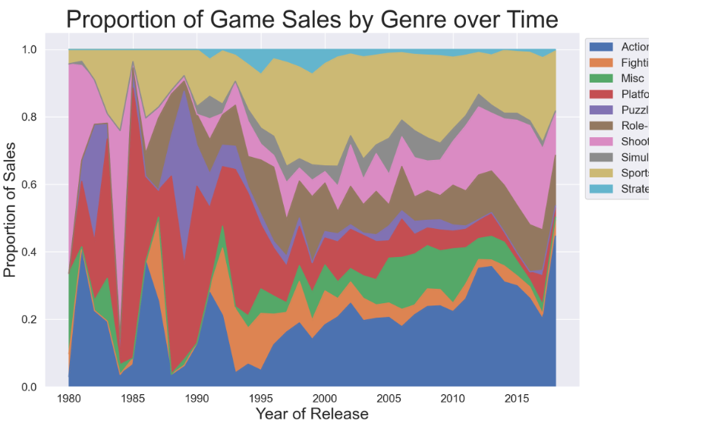
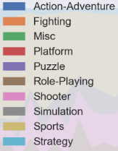
Notes:
Shows us how different genres make up the proportion of total sales in a year
Allows us to see how the popularity of different genres changes over time
Platformers decreased dramatically
Shooters increasing in recent years
Because of this we only look at data after 2000 as it’s more relevant

Slide 6
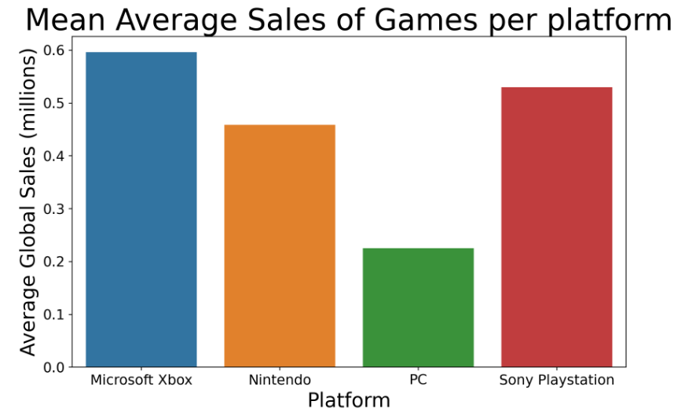
Notes:
graph looks at how games perform when sold on different platforms, using our metric of success global sales
Obvious choice would be to make the game available on multiple platform
Xbox games perform the best, closely followed by playstation
Xbox and playstation in close competition
Playstation are currently outperforming now but this may change
Another thing – releasing games on PC cheaper

Slide 7
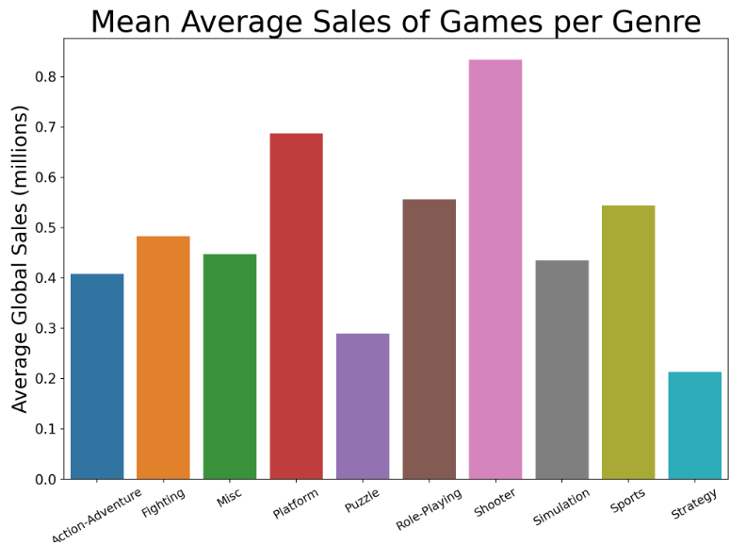
Notes:
Similar to the last graph, looks at how different genres of games perform in global sales
Focus on the top 4 genres; shooter, platform, roleplaying, sport
Could easily say shooter as they are popular
Popular genres reflect more than just what games people like; shows what features they like in games
Shooters and sports games reflect the popularity of multiplayer and competitive; wanting to play with friends or against other people
Platform and RPG reflect wanting aspects of exploration and adventure, a story in which you are the hero, and a tangible measure of progress – levels
Important to note 2D platforms have fallen out of favour – replace by 3D open world games with similar aspects

Slide 8
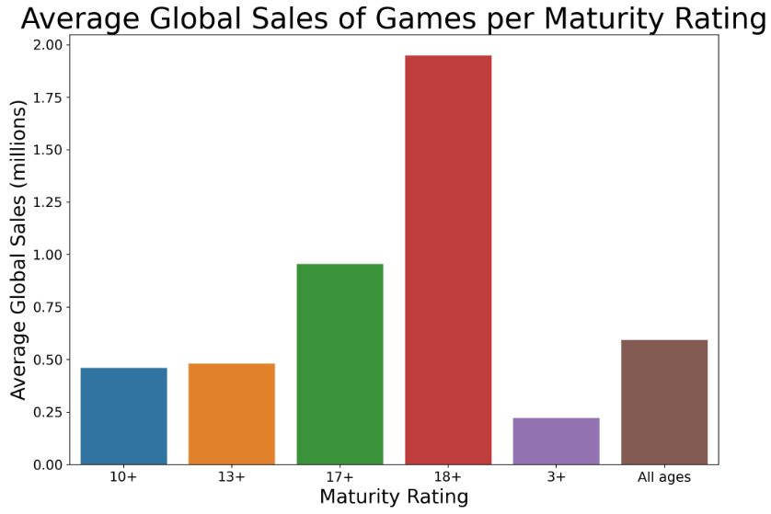

Notes:
final graph looks at success of games depending on their maturity rating, gives us an idea what age demographic to target
Pretty obvious global sales increases at higher age demographics, overwhelmingly for 18+ games

Slide 9

Limitations to the data
Mobile games
Year on Year sales for games
Completeness of data
Notes:
Data doesn’t include mobile games – huge market projected to reach 2.3 bn users in 2027
Yearly data only tells us release date of a game and not how much it sells year on year
We can assume games sell majority of copies within 1-3 years of release but still not completely accurate
Data does not include every game
16,000 after cleaning and even less when looking at games made after 2000

Slide 10
Conclusion
Platform: Playstation or Xbox
Genre: Multiplayer Shooter or Open World RPG
Rating: 18+
Target audience: North America/ English speaking countries
Notes:
Based on the data we have we can conclude that to maximise sales our next game should have the following attributes:
If not multi-platform, Playstation or Xbox
Could be a multiplayer shooter or open world RPG
Or could have all these aspects; an open world RPG shooter with multiplayer functionality
Target an 18+ audience in North America + English speaking countries

Slide 11
Questions?

